Slide 1

DATA ANALYSIS- ITEM SALES ANALYSIS

Slide 2
INTRODUCTION
THIS COMPLETE PROJECT IS ABOUT THE SALES OF THE COMPANY NAME AS BIGMART AND USING THE DATA, CAME UP WITH THE VALUEABLE INSIGHTS IN A DASHBOARD
THIS COMPLETE DATA SET HAS 11 COLUMNS AND TOTAL 8524 ROWS
AND THE FIELDS OR TERMS WHICH THIS DATASET HAS ARE AS FOLLOWS:
ITEM IDENTIFIER, ITEM WEIGHT, ITEM FAT CONTENT, ITEM TYPE, ITEM MRP, OUTLET IDENTIFIER, OUTLET ESTABLISHMENT YEAR, OUTLET SIZE, OUTLET LOCATION TYPE, OUTLET TYPE, ITEM OUTLET SALES, ETC.

Slide 3
WHAT IS THE HIGHEST AND LOWEST SALES IN PARTICULAR YEAR?
HIGHEST:3.6M IN THE YEAR 1985 I.E. 19.54%
LOWEST:0.2M IN THE YEAR 1998 I.E. 1.01%

Slide 4
WHICH ITEM TYPE HAS THE HIGHEST AND LOWEST SALES?
HIGHEST: FRUITS AND VEGETABLES WITH SALES OF 2.8M
LOWEST: SEAFOOD WITH SALES OF 0.1M

Slide 5
WHAT IS THE MAXIMUM AND MINIMUM ITEM WEIGHT OF A ITEM TYPE?
HIGHEST: FRUITS AND VEGETABLES WITH WEIGHT 13480
LOWEST: SEAFOOD WITH WEIGHT 638

Slide 6
WHAT IS THE TOTAL ITEM MRP?
HIGHEST: OUTLETS; SUPERMARKET TYPE1 WITH 65% OF TOTAL MRP
ITEMS; FRUITS AND VEGETABLES HAVING 178K OF MRP
LOWEST: OUTLETS; SUPERMARKET TYPE3 WITH 11% OF TOTAL MRP
ITEMS; SEAFOOD HAVING 9K OF MRP

Slide 7
WHAT IS THE TOTAL COUNT OF FAT CONTENT?
LOW FAT: 5201
REGULAR: 2889
LP: 316
REG: 117

Slide 8
WHICH ITEM TYPE HAS THE HIGHEST SALES IN AN OUTLET ESTABLISHMENT YEAR?
HIGHEST: 1985 WITH SALES OF 1463
LOWEST: 1998 WITH SALES OF 555

Slide 9
WHAT IS THE SALES OF THE OUTLET TYPE ACORDING TO THE OUTLET SIZE?
SUPERMARKET TYPE1 : 12.9M
SUPERMARKET TYPE3 : 3.5M
SUPERMARKET TYPE2 : 1.9M
GROCERY STORE : 0.4M

Slide 10
WHAT IS THE TOTAL SALES OF PARTICULAR LOCATION
TIER 1 : 4.5M
TIER 2 : 6.5M
TIER 3 : 7.6M

Slide 11
WHAT IS TOTAL COUNT OF OUTLET TYPE?
SUPERMARKET TYPE1 : 5577
SUPERMARKET TYPE2 : 928
SUPERMARKET TYPE3 : 935
GROCERY STORE : 1083

Slide 12
CONCLUSION
FROM THE DATA SET, IT IS CONFIRM THAT, YEAR 1985 HAS HIGHEST SALES AND 1998 HAS LOWEST SALES
ALSO FRUITS AND VEGETABLES HAVE THE HIGHEST SALES AND SEAFOOD HAS THE LOWEST SALES
THE MAXIMUM WEIGHT OF THE ITEM TYPE IS 13480 AND THE MINIMUM WEIGHT IS 638
ALSO, SUPERMARKET 1 HAS THE HIGHEST SALES AND SUPERMARKET 3 HAS THE LOWEST SALES
THE TOTAL ITEM MRP IS 1201650.
TOTAL COUNT OF LOW FAT IS 5210, REGULAR IS 2889, LF IS 316 AND REG IS 117
IN YEAR 1985 THE SALES WERE HIGH, AND IN YEAR 1998 THE SALES WERE LOW
THE HIGHEST COUNT OF THE ITEM SALE IS 1463 IN YEAR 1985
THE SUPERMARKET TYPE 1 HAS 12917358 SALES IN ALL OUTLET SIZES
SUPERMARKET TYPE 1 HAS HIGHEST COUNT AND SUPERMAKET TYPE 2 HAS LOWEST COUNT AS 5577 AND 928
TIER 3 HAS HIGHEST SALES AND TIER 1 HAS LOWEST SALES

Slide 13
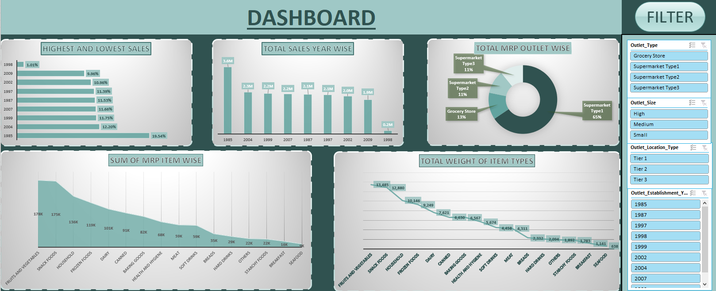
EXCEL DASHBOARD

Slide 14
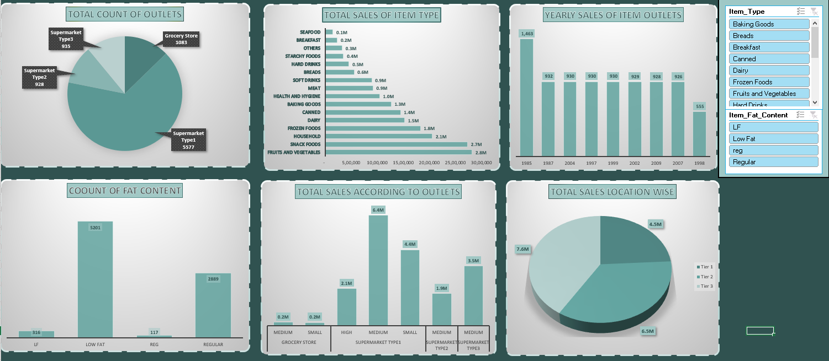

Slide 15
THANK YOU…..

